Slide 1
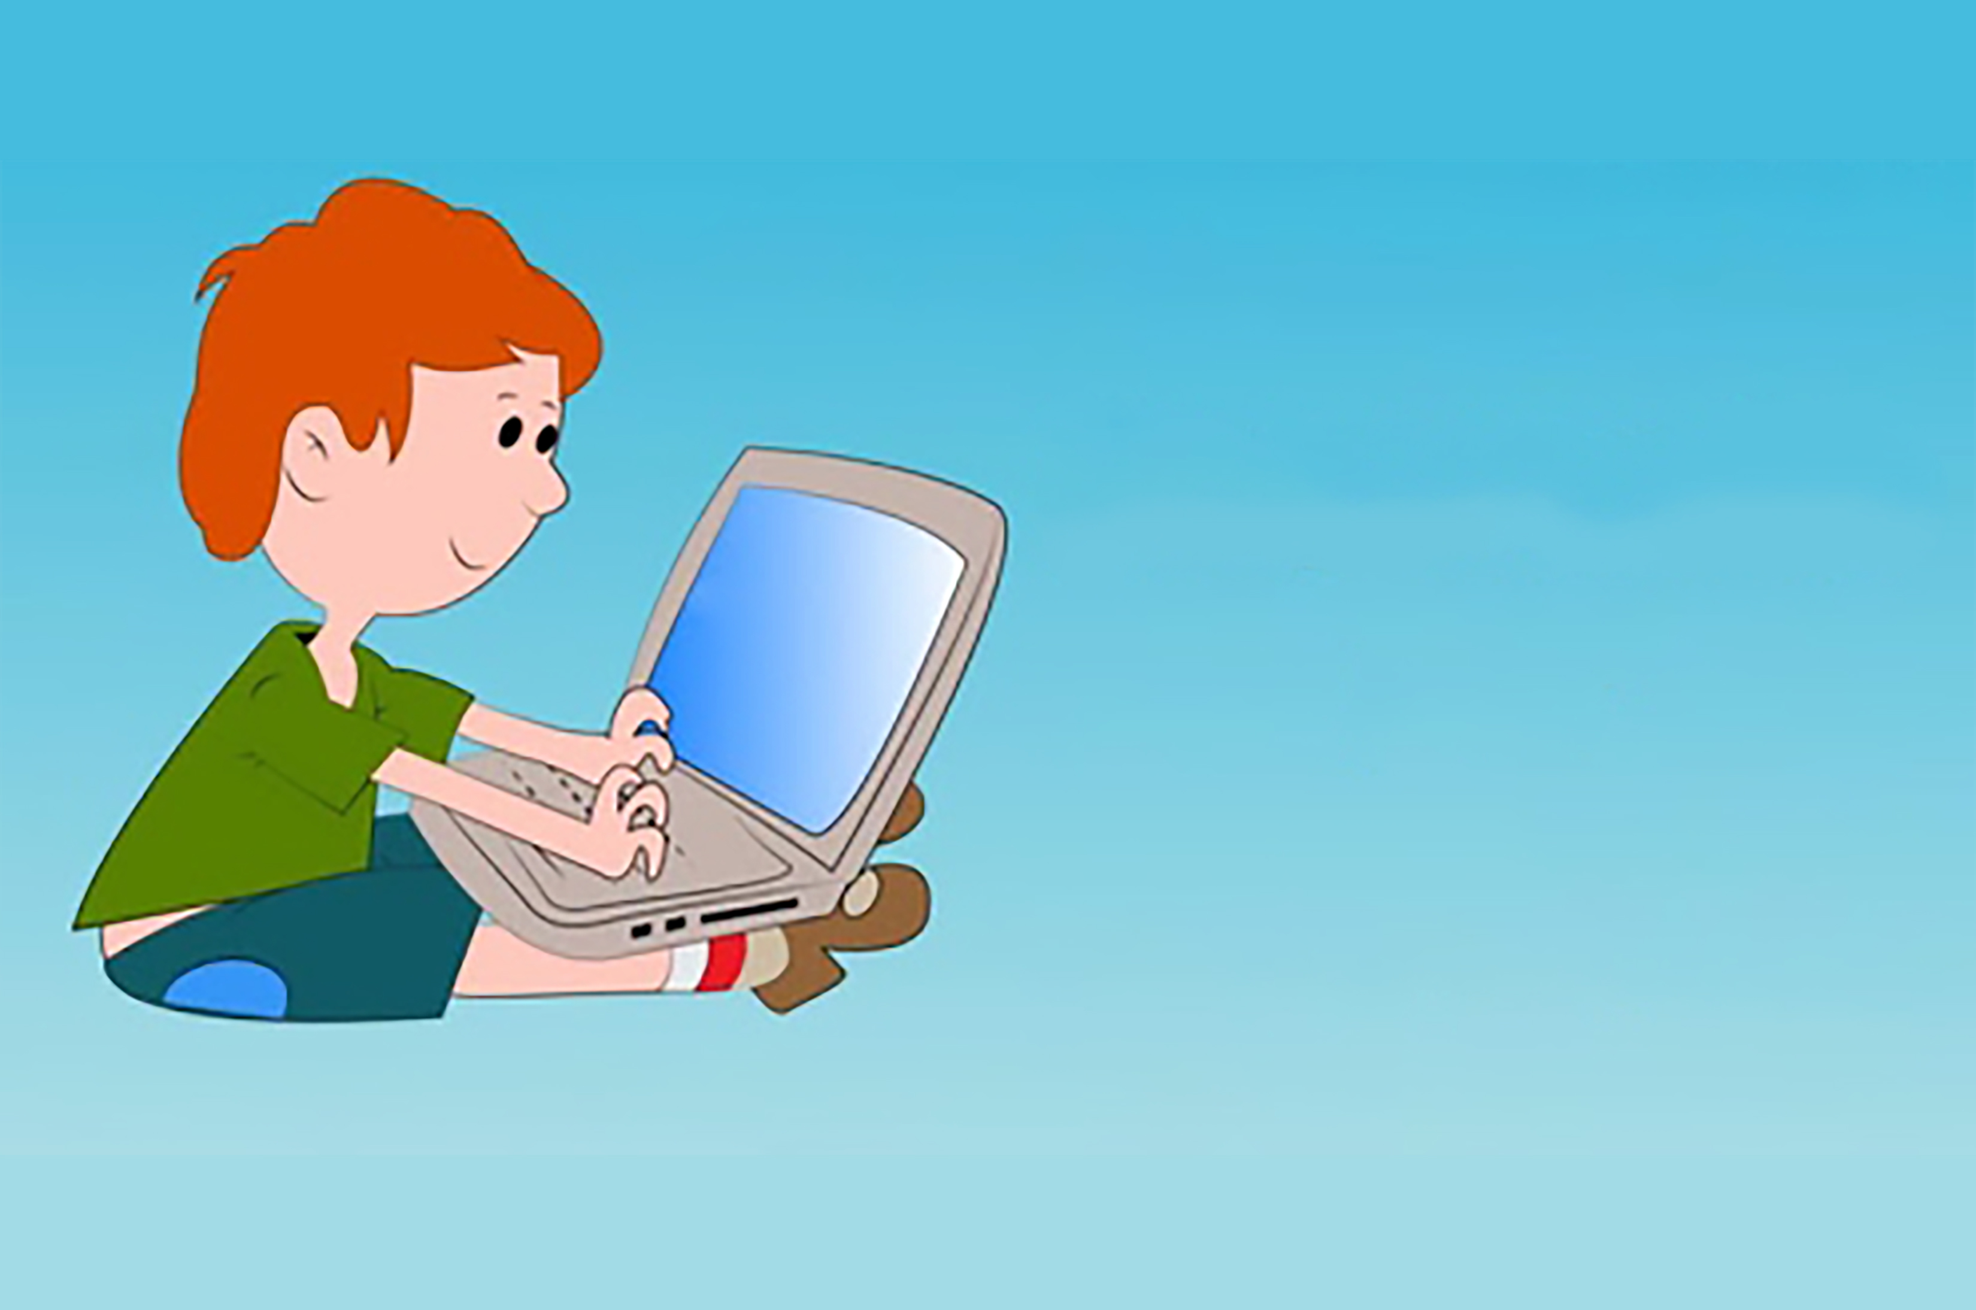

Programming
for
Kids

Slide 2
Introduction to Java
Basic Concepts
Conditionals and Loops
Arrays
Classes and Objects
More on Classes
Exceptions, Lists, Threads

Slide 3
Basic Concepts
Chapter 1
Quiz 1
Introduction to Java
Hello World Program
Java Comments
Variables
Quiz 2
Primitive Operators
Increment, Decrement
Strings
Getting User Input
Chapter 1 - Test

Slide 4



Basic Concepts
Introduction to Java
Platform Independent
Portable
Robust
Dynamic
Write Once, Run Anywhere

Slide 5

Question?
Introduction to Java
When you are putting your application on several different platforms, how many Java versions do you need to create?
Answer: One

Slide 6
Introduction to Java
Google’s Android OS
Desktop Applications
Antivirus Programs
Web Applications
Enterprise Applications

Slide 7

First Java Program
Hello World Program
}
class MyClass {
public static void main (String[] args) {
System.out.println(“Hello World!”);
}
}
In Java every line of code must be inside of a class
1
st
Question?
program
What is the name of the above class?

Slide 8
First Java Program
Hello World Program
}
class MyClass {
public static void main (String[] args) {
System.out.println(“Hello World!”);
}
}
In Java every line of code must be inside of a class
1
st
Question?
program
What is the name of the above class?
Answer: MyClass

Slide 9
First Java Program
Hello World Program
}
Every application must have a main method, and main must have the keywords public and static.
class MyClass {
public static void main (String[] args) {
System.out.println(“Hello World!”);
}
}
1
st
Question?
program
What is the starting point for every Java Program?

Slide 10
First Java Program
Hello World Program
}
Also, every application must have a main method, and main must have the keywords public and static.
class MyClass {
public static void main (String[] args) {
System.out.println(“Hello World!”);
}
}
1
st
Question?
program
What is the starting point for every Java Program?
Answer: main

Slide 11
First Java Program
?
Hello World Program
class MyClass {
public static void main (String[] args) {
System.out.println(“Hello World!”);
}
}
1
st
Question?
program
What are the two keywords every main must have?

Slide 12
First Java Program
?
Hello World Program
class MyClass {
public static void main (String[] args) {
System.out.println(“Hello World!”);
}
}
1
st
Question?
program
What are the two keywords every main must have?
Answer: public and static

Slide 13
The Main Method
Hello World Program
public static void main (String[] args) { }
Public – anyone can access it
public
static
void
main
Static – can be ran without creating an instance of the class containing the main method
Void – doesn’t return any value
Main – the name of the method

Slide 14
Question?
Hello World Program
How would you create a method that doesn’t return any value called “hello()”?
Answer: void hello(){}

Slide 15
println Method
Hello World Program
}
System.out.println(“Hello World!”);
prints Hello World! to the console
Question?
1
st
What method prints a line of text in a Java Program?
program
Answer: println

Slide 16
Semicolons in Java
Hello World Program
}
In Java, each code statement must end with a semicolon ;
I am learning Java!
System.out.println (“ ”) ;
you can put any line of text inside the double quotes
1
st
program

Slide 17
Semicolons in Java
Hello World Program
}
In Java, each code statement must end with a semicolon ;
I am good looking!
I am a smart kid!
I love to code!
System.out.println (“ ”) ;
you can put any line of text inside the double quotes
1
st
program

Slide 18
Fill in the blanks
Hello World Program
_________ Apples {
public static void _______ (String [ ] args) ___
System.______._______(“Hello World”)___
}
____

Slide 19
Fill in the blanks
Hello World Program
class
_________ Apples {
public static void _______ (String [ ] args) ___
System.______._______(“Hello World”)___
}
____
main
{
out
println
;
}
7 blanks

